Slide 1
Memory Management
Notes:
1

Slide 2
Roadmap
Basic requirements of Memory Management
Memory Partitioning
Basic blocks of memory management
Paging
Segmentation
Notes:
Overview of points covered in this chapter
Point out that memory partitioning isn’t used much except for special cases such as kernel memory management
2

Slide 3
The need for memory management
Memory is cheap today, and getting cheaper
But applications are demanding more and more memory, there is never enough!
Memory Management, involves swapping blocks of data from secondary storage.
Memory I/O is slow compared to a CPU
The OS must cleverly time the swapping to maximise the CPU’s efficiency
Notes:
Introduce by pointing out that in a uniprogramming system, main memory is divided into two parts:
one part for the operating system (resident monitor, kernel) and
one part for the program currently being executed.
In a multiprogramming system, the “user” part of memory must be further subdivided to accommodate multiple processes.
Emphasise that memory management is vital in a multiprogramming system. If only a few processes are in memory, then for much of the time all of the processes will be waiting
for I/O and the processor will be idle.
Thus memory needs to be allocated to ensure a reasonable supply of ready processes to consume available processor time.
3

Slide 4
Memory Management
Memory needs to be allocated to ensure a reasonable supply of ready processes to consume available processor time
Notes:
4

Slide 5
Logical Address & Physical Address
Logical Address is generated by CPU while a program is running. The logical address is virtual address as it does not exist physically, therefore, it is also known as Virtual Address. This address is used as a reference to access the physical memory location by CPU. The term Logical Address Space is used for the set of all logical addresses generated by a program’s perspective. The hardware device called Memory-Management Unit is used for mapping logical address to its corresponding physical address.
Physical Address identifies a physical location of required data in a memory. The user never directly deals with the physical address but can access by its corresponding logical address. The user program generates the logical address and thinks that the program is running in this logical address but the program needs physical memory for its execution, therefore, the logical address must be mapped to the physical address by MMU before they are used. The term Physical Address Space is used for all physical addresses corresponding to the logical addresses in a Logical address space.

Slide 6
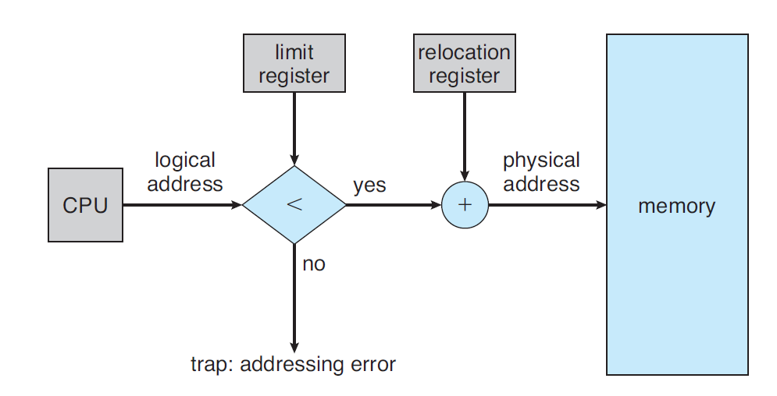
Logical to Physical address translation

Slide 7
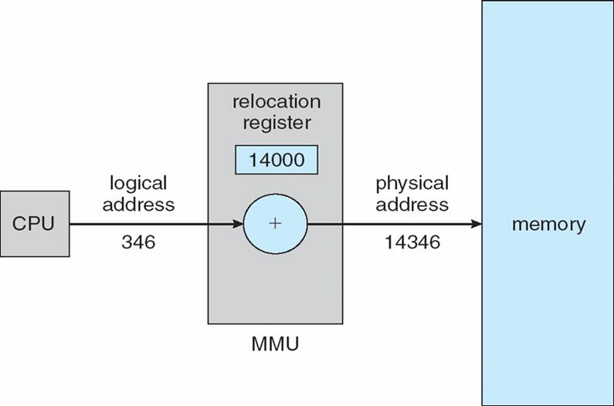
Logical to Physical address translation (Example)

Slide 8
Memory Management Requirements
Relocation
Protection
Sharing
Logical organisation
Physical organisation
Notes:
The following slides expand on these topics.
8

Slide 9
Requirements: Relocation
The programmer does not know where the program will be placed in memory when it is executed,
it may be swapped to disk and return to main memory at a different location (relocated)
Memory references must be translated to the actual physical memory address
Notes:
9

Slide 10
Requirements: Protection
Processes should not be able to reference memory locations in another process without permission
Impossible to check absolute addresses at compile time
Must be checked at run time
Notes:
Normally, a user process cannot access any portion of the operating system, neither program nor data.
Usually, a program in one process cannot branch to an instruction in another process or access the data area of another process. The processor must be able to abort such instructions at the point of execution.
Note that the memory protection requirement must be satisfied by the processor (hardware) rather than the operating system (software) because the OS cannot anticipate all of the memory references that a program will make. It is only possible to assess the permissibility of a memory reference at the time of execution.
Consider asking the students “why” to point 1 & 2.
Why is it a Bad Thing for one process to be able to read, or even write, to memory occupied by a different process?
Why is it impossible to check absolute addresses at compile time (hint: see relocation)
10

Slide 11
Requirements: Sharing
Allow several processes to access the same portion of memory
Better to allow each process access to the same copy of the program rather than have their own separate copy
Notes:
Any protection mechanism must have the flexibility to allow several processes to access the same portion of main memory.
Processes that are cooperating on some task may need to share access to the same data structure.
11

Slide 12
Requirements: Logical Organization
Memory is organized linearly (usually)
Programs are written in modules
Modules can be written and compiled independently
Different degrees of protection given to modules (read-only, execute-only)
Share modules among processes
Segmentation helps here
Notes:
Main memory is usually organized as a linear, or one-dimensional, address space, consisting of a sequence of bytes or words.
Secondary memory, at its physical level, is similarly organized.
This does not correspond to the way in which programs are typically constructed. Most programs are organized into modules. If the operating system and computer hardware can effectively deal with user programs and data in the form of modules of some sort, then a number of advantages can be realized
12

Slide 13
Requirements: Physical Organization
Cannot leave the programmer with the responsibility to manage memory
Memory available for a program plus its data may be insufficient
Overlaying allows various modules to be assigned the same region of memory but is time consuming to program
Programmer does not know how much space will be available
Notes:
Because of this, it is clear that the task of moving information between the two levels of memory should be a system responsibility. This task is the essence of memory management.
13

Slide 14
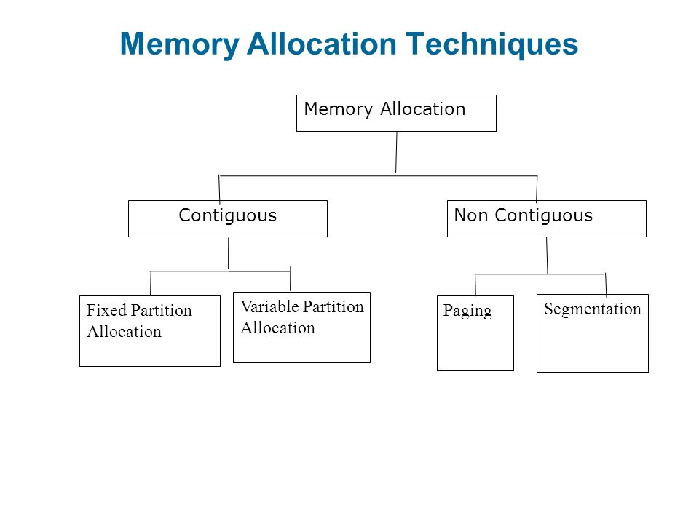
Memory Allocation
In the multiprogramming, the multiple users can share the memory simultaneously.
So the memory is allocated to various processes depending on their requirements.
Following are the types of memory allocation schemes:

Slide 15
Contiguous Memory Allocation
Contiguous memory allocation is a memory allocation method that allocates a single contiguous section of memory to a process or a file.
In the contiguous memory allocation when any user process request for the memory a single section of the contiguous memory block is given to that process according to its need.
We can achieve contiguous memory allocation by dividing memory into the fixed-sized partition but the size of each partition may not be same.
It can be done in two ways:
Fixed Size Partitioning
Variable/Dynamic Size Partitioning
Notes:
15

Slide 16
Contiguous Memory Allocation
Contiguous memory allocation is a memory allocation method that allocates a single contiguous section of memory to a process or a file.
In the contiguous memory allocation when any user process request for the memory a single section of the contiguous memory block is given to that process according to its need.
We can achieve contiguous memory allocation by dividing memory into the fixed-sized partition but the size of each partition may not be same.
It can be done in two ways:
Fixed Size Partitioning
Variable/Dynamic Size Partitioning
Notes:
16

Slide 17
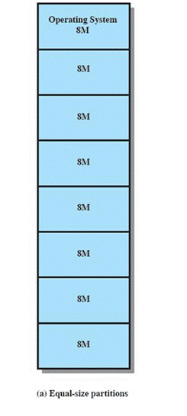
Fixed Partitioning
Equal-size partitions (see fig 7.3a)
Any process whose size is less than or equal to the partition size can be loaded into an available partition
The operating system can swap a process out of a partition
If none are in a ready or running state
Notes:
17

Slide 18
Fixed Partitioning Problems
A program may not fit in a partition.
The programmer must design the program with overlays
Main memory use is inefficient.
Any program, no matter how small, occupies an entire partition.
This is results in internal fragmentation.
NOTE: you may refer below link for better understanding:
https://www.geeksforgeeks.org/fixed-or-static-partitioning-in-operating-system/
Notes:
18

Slide 19
Variable/Dynamic Partitioning
Partitions are of variable length and number
Process is allocated exactly as much memory as required
Suffers from External Fragmentation
NOTE: you may refer below link for better understanding:
https://www.geeksforgeeks.org/variable-or-dynamic-partitioning-in-operating-system/
Notes:
19

Slide 20
Compaction
Compaction is a process in which the free space is collected in a large memory chunk to make some space available for processes.
In Dynamic partitioning, swapping creates multiple fragments in the memory because of the processes moving in and out.
Compaction refers to combining all the empty spaces together and processes.
However, Compaction is a costly affair and so we need a more effective technique for memory allocation i.e. Non-Contiguous Memory allocation techniques.
NOTE: you may refer below link for better understanding of Compaction:
https://www.javatpoint.com/os-compaction
Notes:
20

Slide 21
Memory Allocation Algorithms
1. First-fit: the first hole that is found to be large enough for a process to accommodate is selected.
2. Best-fit: This method needs the list of free holes to be sorted according to their size. Then the smallest hole that is large enough for the process to accommodate is selected from the list of free holes. This strategy reduces the wastage of memory as it does not allocate a hole of larger size which leaves some amount of memory even after the process accommodates the space.
3. Worst-fit: This method requires the entire list of free holes to be sorted. Here, again the largest hole among the free holes is selected. This strategy leaves the largest leftover hole which may be useful for the other process.
For numericals based on this scheme: refer class notes and video lectures that are shared !
Notes:
21

Slide 22
Non-Contiguous Memory allocation
In the non-contiguous memory allocation the available free memory space are scattered here and there and all the free memory space is not at one place. So this is time-consuming.
In the non-contiguous memory allocation, a process will acquire the memory space but it is not at one place it is at the different locations according to the process requirement.
This technique of non-contiguous memory allocation reduces the wastage of memory which leads to internal and external fragmentation.
This utilizes all the free memory space which is created by a different process.
Non-contiguous memory allocation is of different types,
Paging
Segmentation
Segmentation with paging
Notes:
22

Slide 23
Paging
Paging is a memory management scheme that eliminates the need for contiguous allocation of physical memory. This scheme permits the physical address space of a process to be non – contiguous.
Logical Address or Virtual Address (represented in bits): An address generated by the CPU
Logical Address Space or Virtual Address Space( represented in words or bytes): The set of all logical addresses generated by a program
Physical Address (represented in bits): An address actually available on memory unit
Physical Address Space (represented in words or bytes): The set of all physical addresses corresponding to the logical addresses.
Notes:
23

Slide 24
Paging
Example:
If Logical Address = 31 bit, then Logical Address Space = 2^31 (2.2^30) words = 2 G words (1 G = 2^30)
If Logical Address Space = 128 M words = 2^7 * 2^20 words, then Logical Address = log2 (2^27) = 27 bits
If Physical Address = 22 bit, then Physical Address Space = 2^22 words = 4 M words (1 M = 2^20)
If Physical Address Space = 16 M words = 24 * 2^20 words, then Physical Address = log2 (2^24) = 24 bits
The mapping from virtual to physical address is done by the memory management unit (MMU) which is a hardware device and this mapping is known as paging technique.
The Physical Address Space is conceptually divided into a number of fixed-size blocks, called frames.
The Logical address Space is also splitted into fixed-size blocks, called pages.
Page Size = Frame Size
Notes:
24

Slide 25
Paging
Address generated by CPU is divided into
Page number(p): Number of bits required to represent the pages in Logical Address Space or Page number
Page offset(d): Number of bits required to represent particular word in a page or page size of Logical Address Space or word number of a page or page offset.
Physical Address is divided into
Frame number(f): Number of bits required to represent the frame of Physical Address Space or Frame number.
Frame offset(d): Number of bits required to represent particular word in a frame or frame size of Physical Address Space or word number of a frame or frame offset.
Notes:
25

Slide 26
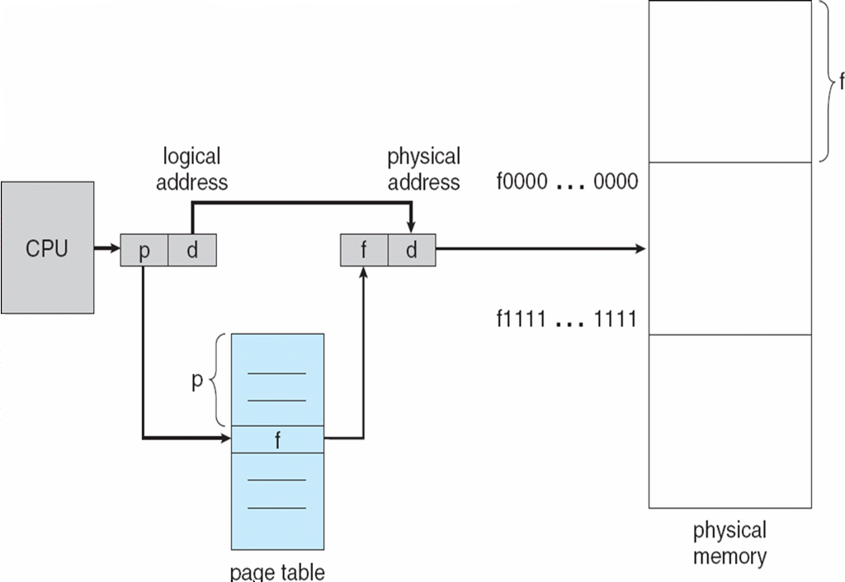
Paging Hardware (also called Address Translation in Paging)
Notes:
26

Slide 27
Paging advantages and Disadvantages
Advantages:
It is independent of external fragmentation.
Disadvantages:
It makes the translation very slow as main memory access two times.
A page table is a burden over the system which occupies considerable space.
It may suffer from internal fragmentation as pages are of fixed size.
Notes:
27

Slide 28
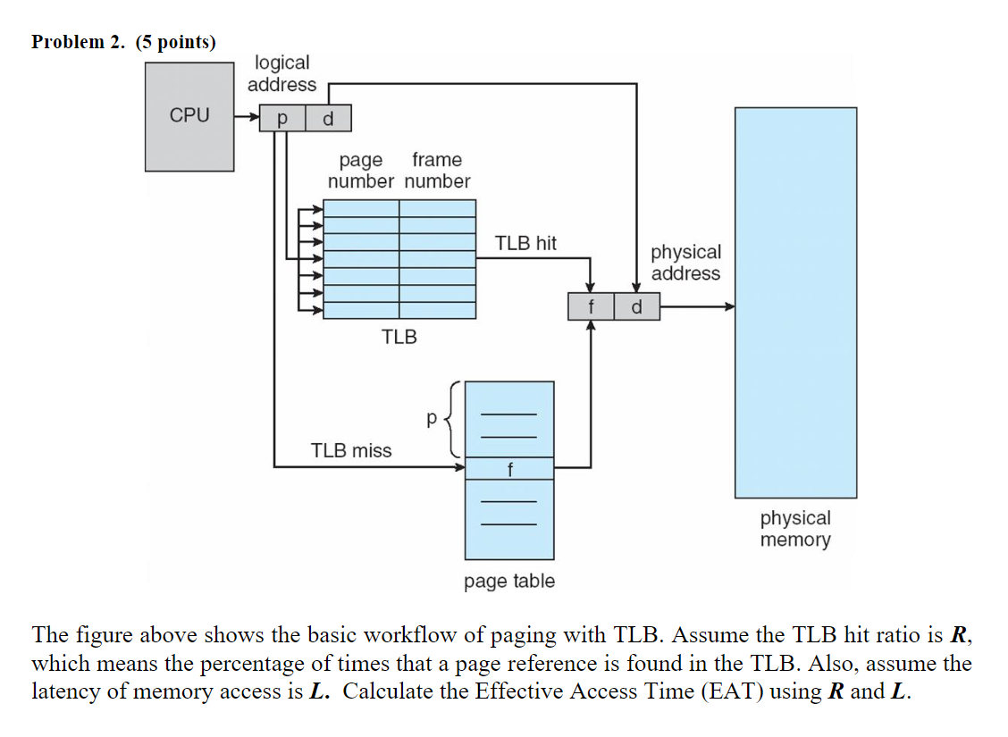
PAGING WITH TLB

Slide 29
Effective memory access time (EMAT)
Effective memory access time(EMAT) : TLB is used to reduce effective memory access time as it is a high speed associative cache.
EMAT = h*(c+m) + (1-h)*(c+2m)
where, h = hit ratio of TLB m = Memory access time c = TLB access time

Slide 30
Q: A paging scheme uses a Translation Lookaside buffer (TLB). A TLB access takes 10 ns and a main memory access takes 50 ns. What is the effective access time (in ns) if the TLB hit ratio is 90% and there is no page fault?
Given-
TLB access time = 10 ns
Main memory access time = 50 ns
TLB Hit ratio = 90% = 0.9
Calculating TLB Miss Ratio-
TLB Miss ratio
= 1 – TLB Hit ratio
= 1 – 0.9
= 0.1
Calculating Effective Access Time-
Substituting values in the above formula, we get-
Effective Access Time
= 0.9 x { 10 ns + 50 ns } + 0.1 x { 10 ns + 2 x 50 ns }
= 0.9 x 60 ns + 0.1 x 110 ns
= 54 ns + 11 ns
= 65 ns

Slide 31
Segmentation
Segmentation is a programmer view of the memory where instead of dividing a process into equal size partition we divided according to program into partition called segments.
A logical address space (user program) is a collection of segments.
A segment is a logical unit such as:
main program, procedure, function, method, object, local variables, global variables, common block, stack, symbol table, arrays etc. are different segments of a program
The translation in segmentation is the same as paging but paging segmentation is independent of internal fragmentation but suffers from external fragmentation.
Address generated by the CPU is divided into:
Segment number (s): Number of bits required to represent the segment.
Segment offset (d): Number of bits required to represent the size of the segment.
Notes:
31

Slide 32
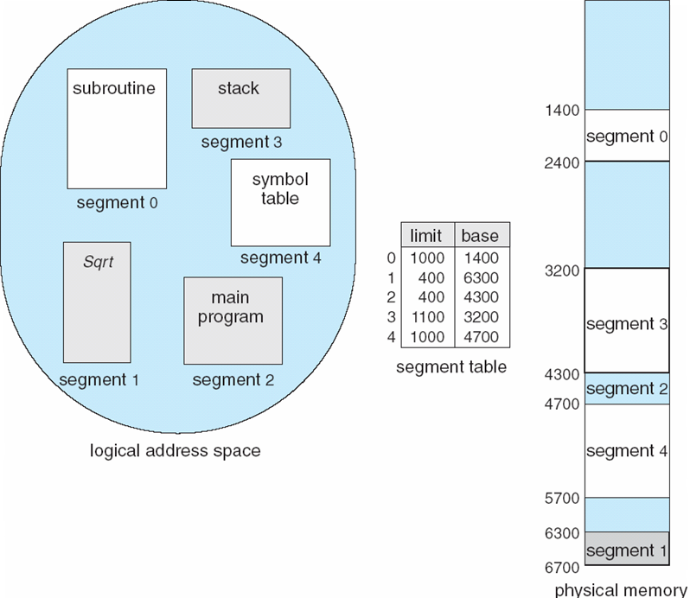
Example of Segmentation

Slide 33
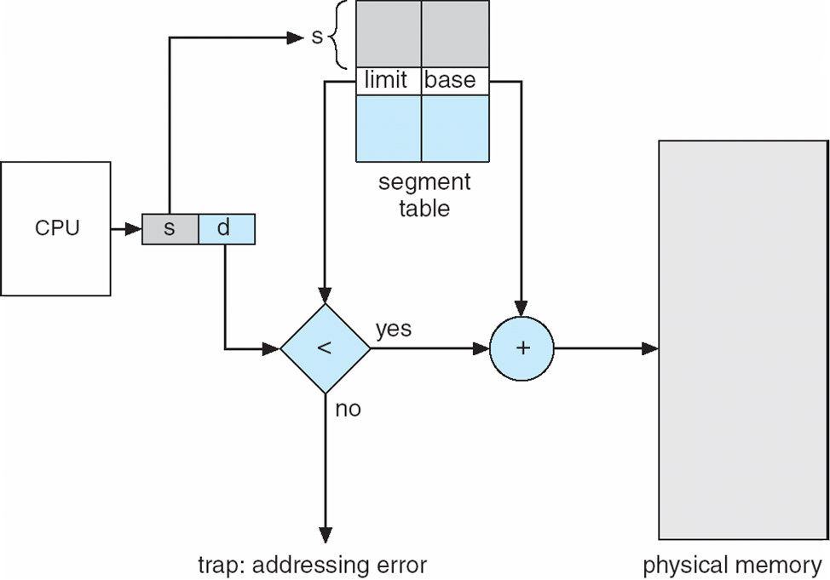
Segmentation Hardware (also called Address Translation in Segmentation)

Slide 34
Segmentation advantages and Disadvantages
Advantages of Segmentation –
No Internal fragmentation.
Segment Table consumes less space in comparison to Page table in paging.
Disadvantage of Segmentation –
As processes are loaded and removed from the memory, the free memory space is broken into little pieces, causing External fragmentation.
Notes:
34

Slide 35
Virtual Memory
A computer can address more memory than the amount physically installed on the system. This extra memory is actually called virtual memory and it is a section of a hard disk that's set up to emulate the computer's RAM.
The main visible advantage of this scheme is that programs can be larger than physical memory. Virtual memory serves two purposes. First, it allows us to extend the use of physical memory by using disk. Second, it allows us to have memory protection, because each virtual address is translated to a physical address.
In real scenarios, most processes never need all their pages at once, for following reasons :
Error handling code is not needed unless that specific error occurs, some of which are quite rare.
Arrays are often over-sized for worst-case scenarios, and only a small fraction of the arrays are actually used in practice.
Certain features of certain programs are rarely used.
Notes:
35

Slide 36
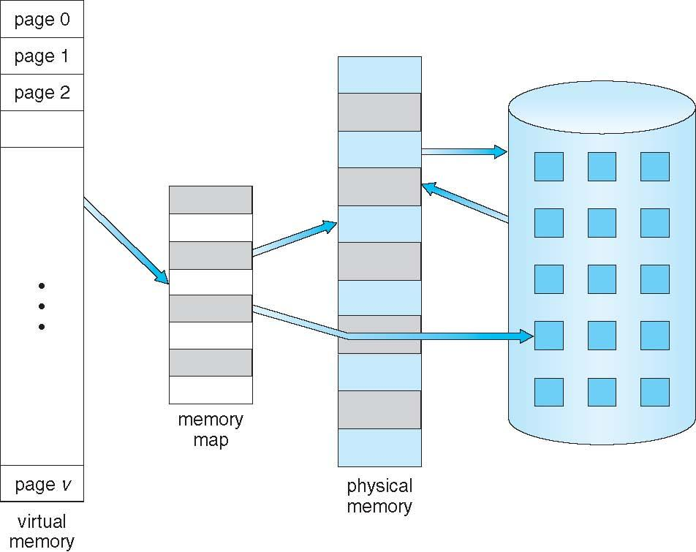
Virtual Memory That is Larger Than Physical Memory

Slide 37
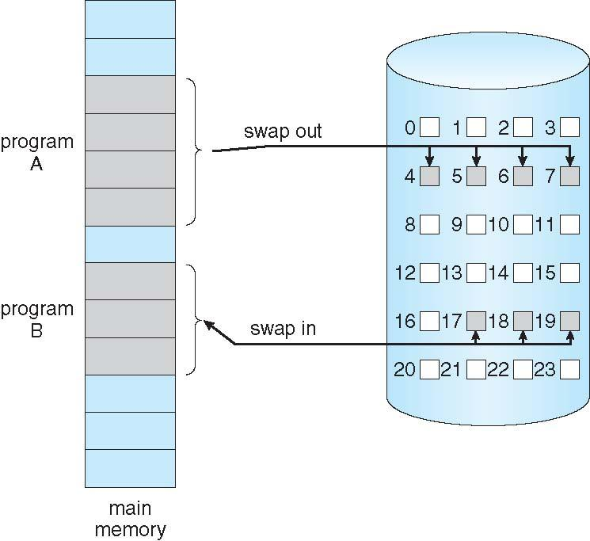
Demand Paging
Virtual memory is commonly implemented by demand paging.
The basic idea behind demand paging is that when a process is swapped in, its pages are not swapped in all at once.
Rather they are swapped in only when the process needs them(On demand).
This is termed as lazy swapper, although a pager is a more accurate term.
Notes:
37

Slide 38
Demand Paging
Initially only those pages are loaded which will be required the process immediately.
The pages that are not moved into the memory, are marked as invalid in the page table. For an invalid entry the rest of the table is empty. In case of pages that are loaded in the memory, they are marked as valid along with the information about where to find the swapped out page.
When the process requires any of the page that is not loaded into the memory, a Page fault occurs! Then, a page fault trap is triggered and following steps are followed,
The memory address which is requested by the process is first checked, to verify the request made by the process.
If its found to be invalid, the process is terminated.
In case the request by the process is valid, a free frame is located, possibly from a free-frame list, where the required page will be moved.
A new operation is scheduled to move the necessary page from disk to the specified memory location. ( This will usually block the process on an I/O wait, allowing some other process to use the CPU in the meantime. )
When the I/O operation is complete, the process's page table is updated with the new frame number, and the invalid bit is changed to valid.
The instruction that caused the page fault must now be restarted from the beginning.
Notes:
38

Slide 39
Page Fault Service Time
The time taken to service the page fault is called as page fault service time.
The page fault service time includes the time taken to perform all the above six steps.
Let Main memory access time is: m
Page fault service time is: s
Page fault rate is : p
Then, Effective memory access time = (p*s) + (1-p)*m
NOTE:
There are cases when no pages are loaded into the memory initially, pages are only loaded when demanded by the process by generating page faults. This is called Pure Demand Paging.
The only major issue with Demand Paging is, after a new page is loaded, the process starts execution from the beginning. Its is not a big issue for small programs, but for larger programs it affects performance drastically.
Notes:
39

Slide 40
Page Replacement
As studied in Demand Paging, only certain pages of a process are loaded initially into the memory. This allows us to get a greater number of processes into the memory at the same time. but what happens when a process requests for more pages and no free memory is available to bring them in. Following steps can be taken to deal with this problem :
Put the process in the wait queue, until any other process finishes its execution thereby freeing frames.
Or remove some other process completely from the memory to free frames.
Or find some pages that are not being used right now, move them to the disk to get free frames. This technique is called Page replacement and is most used. We have some great algorithms to carry on page replacement efficiently.
Notes:
40

Slide 41
Basic Page Replacement
Find the location of the page requested by ongoing process on the disk.
Find a free frame. If there is a free frame, use it. If there is no free frame, use a page-replacement algorithm to select any existing frame to be replaced, such frame is known as victim frame.
Write the victim frame to disk. Change all related page tables to indicate that this page is no longer in memory.
Move the required page and store it in the frame. Adjust all related page and frame tables to indicate the change.
Restart the process that was waiting for this page.
There are three basic page replacement algos:
First In First Out (FIFO)
Optimal
Least Recently used (LRU)
Second Chance (SC)
Not recently used (NRU)
Notes:
41

Slide 42
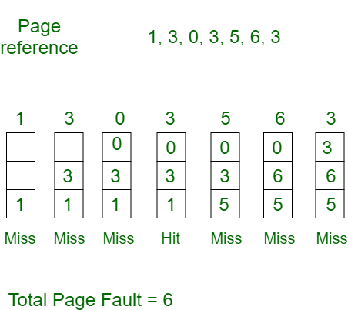
FIFO
First In First Out (FIFO) –
This is the simplest page replacement algorithm. In this algorithm, the operating system keeps track of all pages in the memory in a queue, the oldest page is in the front of the queue. When a page needs to be replaced page in the front of the queue is selected for removal.
Example-1Consider page reference string 1, 3, 0, 3, 5, 6 with 3 page frames. Find number of page faults.
Notes:
42

Slide 43
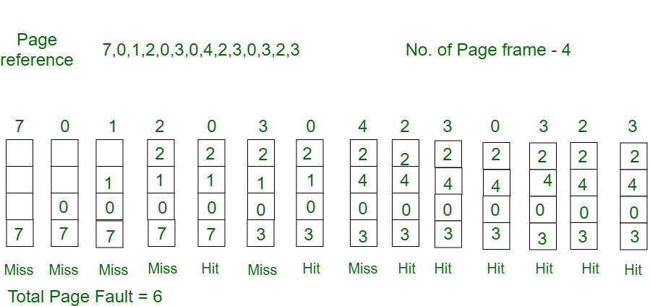
OPTIMAL
Optimal Page replacement –
In this algorithm, pages are replaced which would not be used for the longest duration of time in the future.
Example-2:Consider the page references 7, 0, 1, 2, 0, 3, 0, 4, 2, 3, 0, 3, 2, with 4 page frame. Find number of page fault.
Notes:
43

Slide 44
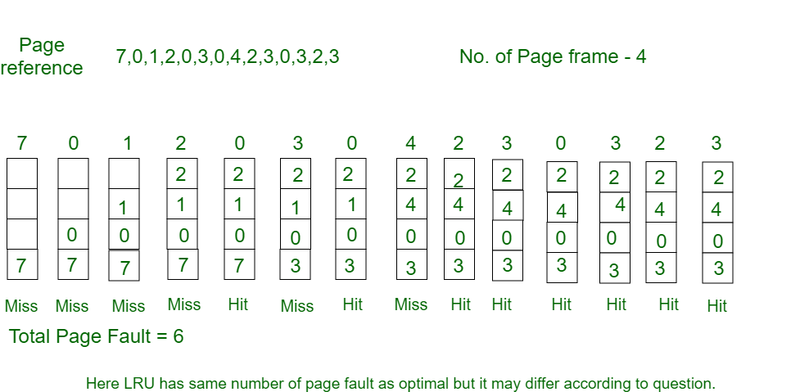
LRU
Least Recently Used –
In this algorithm page will be replaced which is least recently used.
Example-3Consider the page reference string 7, 0, 1, 2, 0, 3, 0, 4, 2, 3, 0, 3, 2 with 4 page frames.Find number of page faults.
Notes:
44

Slide 45
Thrashing
A process that is spending more time paging than executing is said to be thrashing.
Early process scheduling schemes would control the level of multiprogramming allowed based on CPU utilization, adding in more processes when CPU utilization was low.
The problem is that when memory filled up and processes started spending lots of time waiting for their pages to page in, then CPU utilization would lower, causing the schedule to add in even more processes and exacerbating the problem! Eventually the system would essentially grind to a halt.
Local page replacement policies can prevent one thrashing process from taking pages away from other processes, but it still tends to clog up the I/O queue, thereby slowing down any other process that needs to do even a little bit of paging ( or any other I/O for that matter. )
Notes:
45

Slide 46
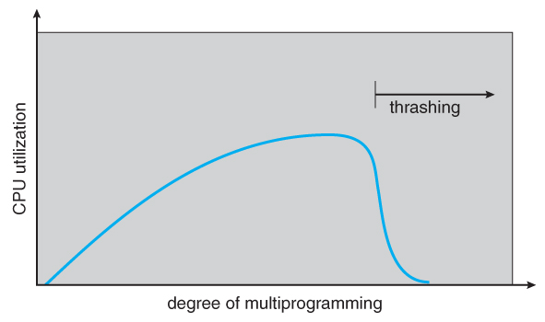
Thrashing
Notes:
46

